Slide 1





WEB DEVELOPMENT
By arun agarwal

Slide 2

Survey/pre-quiz:
Are you considering a field in computer science or related majors?
Are you considering web development specifically?
What is web development?
Why is web development important?

Slide 3

Overview:
What is Web Development?
Areas of Web Development
Necessary Skills
How Do You Become a Web Developer?
Importance
Salaries
Career Advancement
Video(s)
Live Demonstrations
Friendly Competition
Other Resources
Works Cited

Slide 4
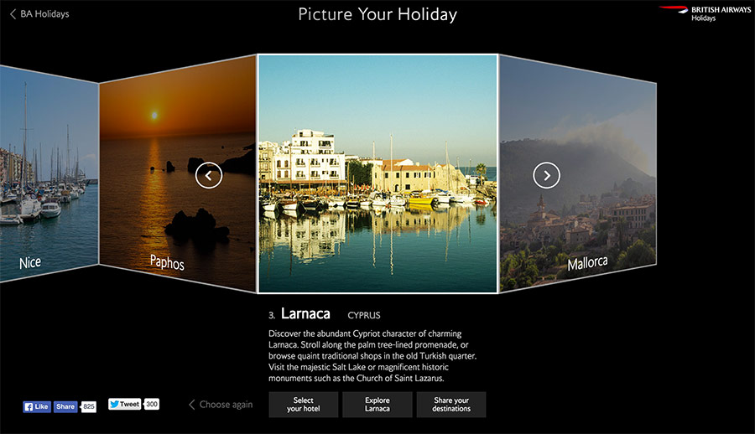
What is web development?
Designing and coding websites used everyday
Visual Presentation
Interactive Features
Capacity
Backend Structure
Creativity→ Code
JavaScript, HTML, CSS
15% GROWTH

Slide 5
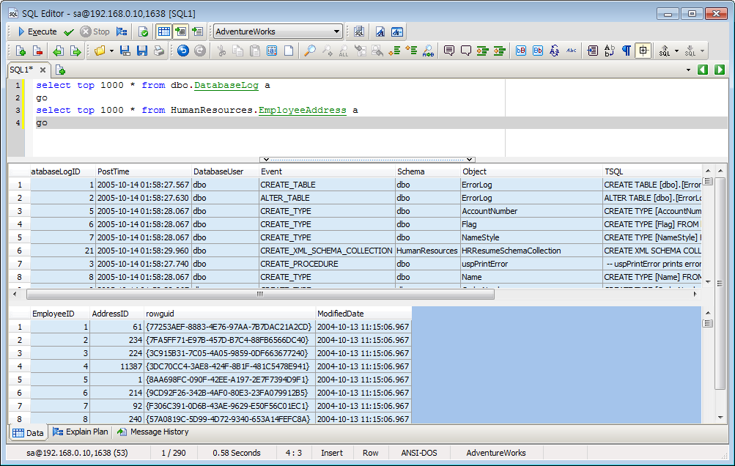



Areas of web development:
SQL/DATABASE DEVELOPMENT:
WEB DESIGN:
MOBILE WEB DEVELOPMENT:
PHP DEVELOPMENT:

Slide 6


Necessary skills:
Technical skills and a sense for intuitive design
Fluency in JavaScript, SQL, PHP, HTML, XML & CSS
Familiarity with multiple operating systems & mobile platforms
Eye for design & ability to build visually-appealing websites
Excellent communication & visual presentation skills for working with clients
Ability to perform detail-oriented, creative work independently or with limited supervision

Slide 7



How do you become a web developer?
HOW DO YOU BECOME A WEB DEVELOPER?
Need: knowledge of languages and systems used to create websites
Skills built in school (usually)
Can be self-taught
Many employers look for formal training
Four year-degree: colleges w/ IT departments
Take a class or tutorial
Work your way up
Practice, Practice, Practice
Ask Questions
Talk to your Teachers/Professors

Slide 8
BUT WHY SHOULD you CARE???

Slide 9










Importance:
YOU TELL ME…
Websites help us with almost everything!!!!
Marketing a product
Distributing information
Allowing a company & its products to become known
Watching a show or video
Discovering new jobs and other opportunities
Finding and purchasing products
Banking and Stock Market
WE ARE IN A TECHNOLOGY DRIVEN WORLD
We then need websites to help push innovation

Slide 10

LET’S TALK $$$

Slide 11
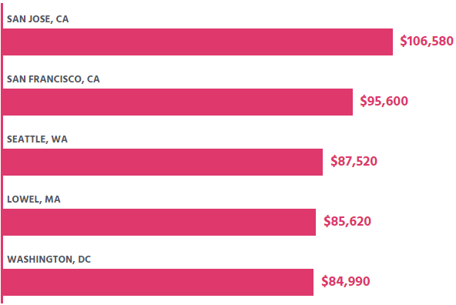
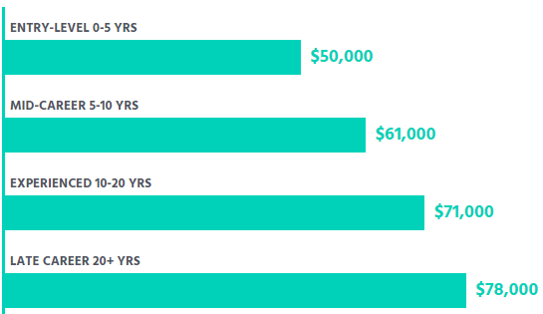
Salaries:
STATE | EMPLOYMENT PER 1,000 PEOPLE | EMPLOYMENT | AVG. ANNUAL SALARY
DISTRICT OF COLUMBIA | 1.84 | 1,240 | $78,710
OREGON | 1.71 | 2,880 | $69,250
WASHINGTON | 1.66 | 4,810 | $82,420
VERMONT | 1.58 | 470 | $65,570
UTAH | 1.56 | 2,000 | $58,490
INDUSTRY | AVG. ANNUAL SALARY
SEMICONDUCTOR AND OTHER ELECTRONIC COMPONENT MANUFACTURING | $87,440
SOFTWARE PUBLISHERS | $86,590
DEPOSITORY CREDIT INTERMEDIATION | $84,010
MONETARY AUTHORITIES-CENTRAL BANK | $83,510
No established pay scale
Varies widely
State, city, experience, and industry
2014 average salary:
One website: $68, 670
A different website: $55,000
A different website: $87,000

Slide 12

Career advancement:
Build a great portfolio!!!
Be versatile
Include: websites designed and built, freelance work, & larger projects you’ve helped with
Build your own website to host portfolio
Most move to senior management roles
More experience→ Freelancing or Consulting
Numerous certification programs
General certifications, language-specific programs and design workshops

Slide 13

Video on web development:
Link: https://www.youtube.com/watch?v=GEfuOMzRgXo

Slide 14


Video on web development vs web design:
Link: https://www.youtube.com/watch?v=Ujc3yhN9E5Y

Slide 15

Live demonstration:
Link: www.wix.com

Slide 16

Kahoot:
Link: https://play.kahoot.it/#/k/1ccc9e7c-27c4-4378-96ec-e4d29d639910

Slide 17

OTHER RESOURCES:
https://teamtreehouse.com/
https://developer.mozilla.org/en-US/docs/Web/Guide
https://www.html-5-tutorial.com/
https://www.codeavengers.com/profile#all?web/1
https://www.sitepoint.com/
http://www.activejump.com/
https://www.webdeveloper.com/forum/
https://uptodate.frontendrescue.org/
https://stackoverflow.com/
https://www.aiga.org/
http://iwanet.org/
https://www.awdp.org/
https://www.w3.org/Consortium/membership-benefits.html
http://webprofessionals.org/
https://weworkremotely.com/
https://stackoverflow.com/jobs/developer-jobs-using-web-development
https://authenticjobs.com/
https://angel.co/jobs
https://www.glassdoor.com/Job/web-developer-jobs-SRCH_KO0,13.htm

Slide 18
WORKS CITED:
https://blennd.com/top-5-best-website-designs-that-tell-a-story/
https://www.computerscience.org/careers/web-developer/
https://www.google.com → search engine for pictures, videos, etc.
https://www.wix.com → website for live demonstration
https://play.kahoot.it/#/k/1ccc9e7c-27c4-4378-96ec-e4d29d639910 → interactive game
https://www.youtube.com/watch?v=GEfuOMzRgXo
https://www.youtube.com/watch?v=Ujc3yhN9E5Y → Web design vs development
https://www.bls.gov -→ website used for various labor statistics

